Slide 1
Project 1 Clustering
Angela Ji, Matthew Bloom, Kenneth Marenco, Abhinav Ratnagiri

Slide 2
Problem Description
NCAA “clusters” colleges and universities into different conferences. 5 of the 10 FBS conferences are known as the Power 5 football athletic conferences.
Power 5
Atlantic Coast Conference (ACC)
Big Ten Conference (BIG)
Big 12 Conference
Pac-12 Conference
Southerneastern Conference (SEC)
Notes:
Angela

Slide 3
Data Collection
Name
Geographic Location
Longitude and Latitude
Conference
# of NFL Players
Home City Population (thousands)
Graduation rate (2011)
Student Population
Notes:
Angela

Slide 4
Methods of Clustering
Hierarchical Clustering (complete linkage)
Geographic (latitude and longitude)
# of NFL Players
Student Population
Others
K-means
Relatively unsuccessful - algorithmic failure for our data
Method for categorizing
Notes:
Angela

Slide 5
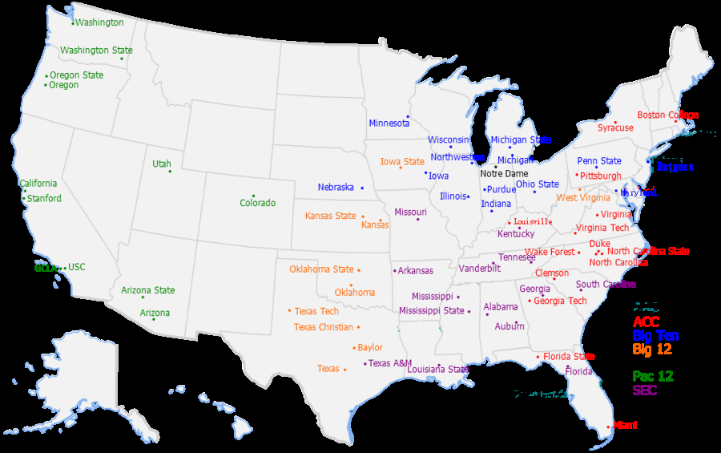
Actual Conferences
Notes:
Kenneth

Slide 6
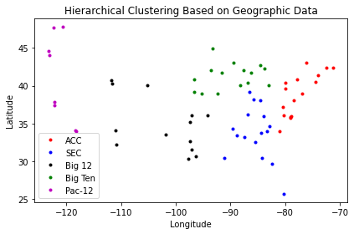
Geographic Data
Notes:
Kenneth

Slide 7
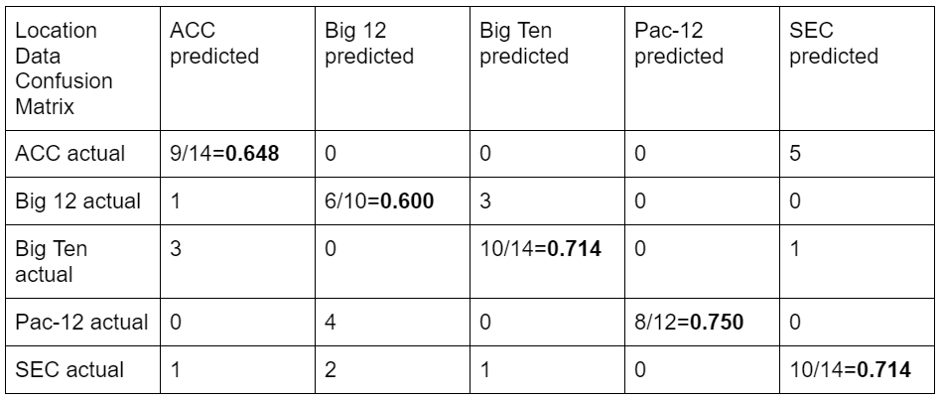
Part I: Location Data
Notes:
Kenneth

Slide 8
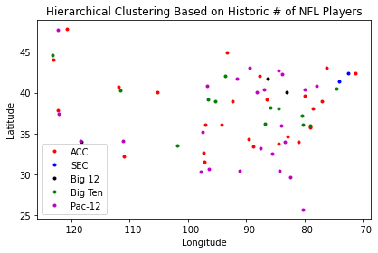
Historical NFL Player Data
Notes:
Abhinav

Slide 9
Results of Clustering
Location Data: 43/64=67.2% success rate
NFL players: 16/64=25% success rate
Student Population: 19/64=29.7% success rate
Independent Schools:
BYU: Big 12
US Military Academy: ACC
UMass-Amherst: ACC
Notre Dame: Big Ten
Notes:
Abhinav

Slide 10
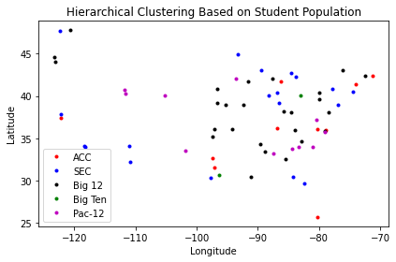
Part II: Student Population Data
Notes:
matthew

Slide 11
New Conferences
ACC | Big 12 | Big Ten | Pac-12 | SEC
NC State | Boston College | Florida State | Virginia | tOSU
Virginia Tech | Wake Forest | UT Austin | Pitt | Texas A&M
Georgia Tech | Duke | Purdue | Syracuse
Iowa State | Miami (FL) | Maryland | UNC
Texas Tech | TCU | Minnesota | Clemson
BYU | Baylor | UIUC | Louisville
Utah | Notre Dame | Indiana | Kansas
UCo Boulder | Army | Penn State | Oklahoma
South Carolina | Stanford | Michigan | West Virginia
Georgia | Vanderbilt | Michigan State | Oklahoma State
Alabama |  | ... | ...
Notes:
matthew

Slide 12
Conclusions & Discussion
Location clearly strongest correlation
Adding variables was worse - alternate variables? weights?
Student population could make some conferences more competitive
Downside: travel
Inequality of attendance
Consolidating conferences?
Pac-12 and BIG don’t fit on a slide!
Notes:
matthew

